Slide 1
PROJECT PRESENTATION ON
“ACTORS PROTFOILIO”
Submitted by:
DATTASAI.(lead)
PRATHYUSHA.
HARSHITHA.

Slide 2
AGENDA:
Introduction.
Home page.
About page.
View moredetails.
Projects.
Protfolio.
Contact page.
Team Members.

Slide 3
INTRODUCTION:
This Project is about the currently active actor.
Actors portfolio is used to store and keep the records of the actors and it was handeled by him.
This system manages all contact and personal details of actor .
We developed this website by using css ,html,and bootstrap.
Here in this project we created Home page, AboutUs,Myproject details ,Actor Protfolio and also Contact Page.

Slide 4
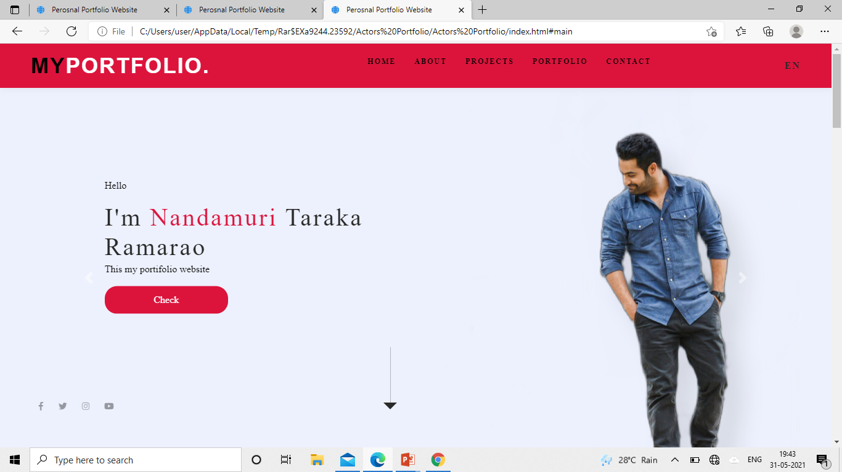
HOME PAGE:
This page is use to enter the credentials and also we can see the profile of actor.

Slide 5
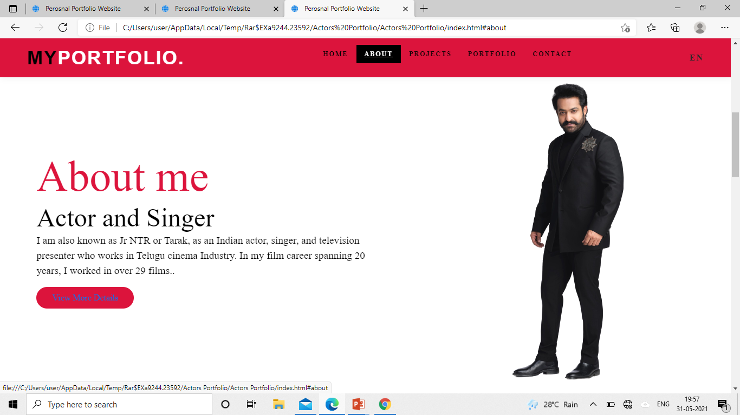
ABOUT PAGE:
In this page we can see about the actor background.and also we can see details of the actor.

Slide 6
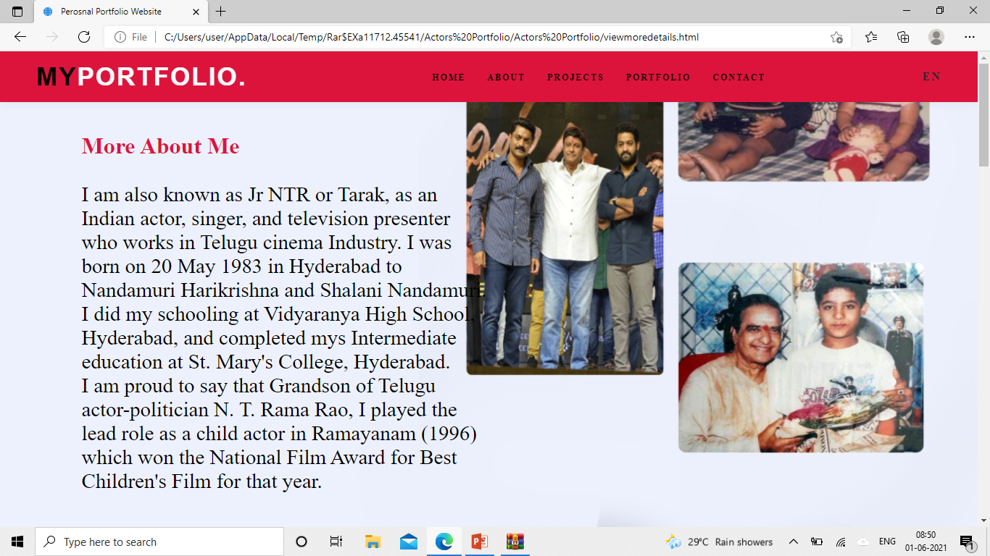
View Moredetails Page:
This page contains more details of an actor like family background ,awards ,hobbies and his/her works contribution to the society.

Slide 7
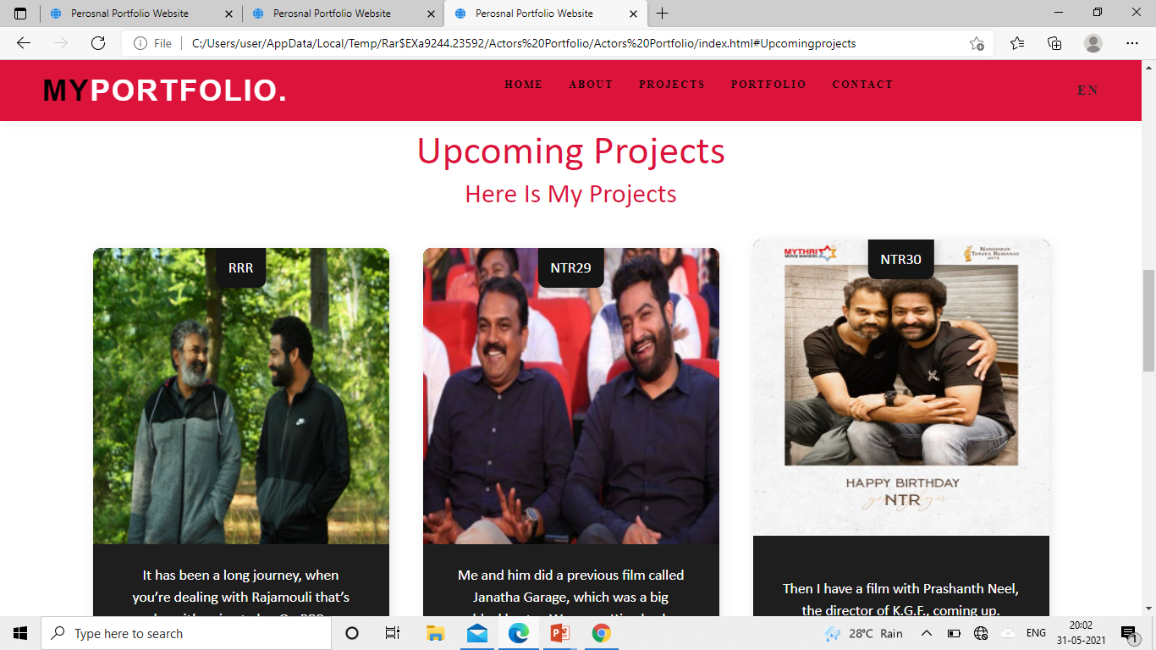
Project Page:
This page contains about the upcoming projects of actor.

Slide 8
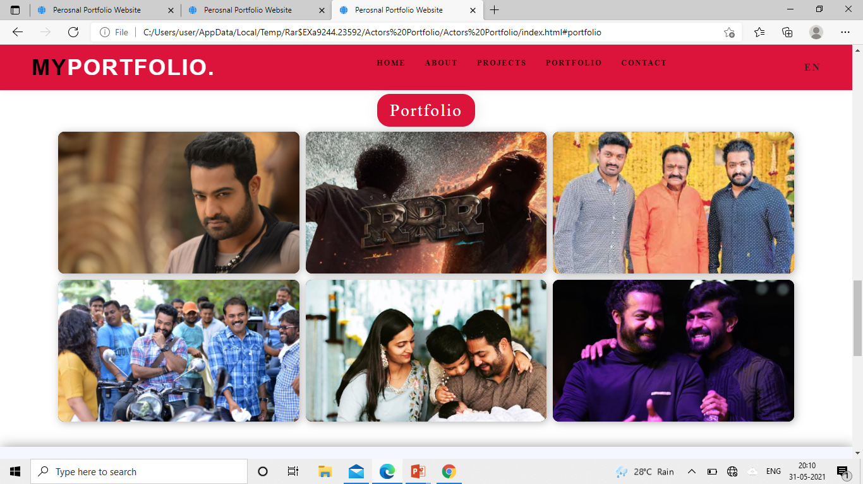
Protfolio Page:
This page contains images of an actor ,family pictures,latest film pictures and also upcoming films images.

Slide 9
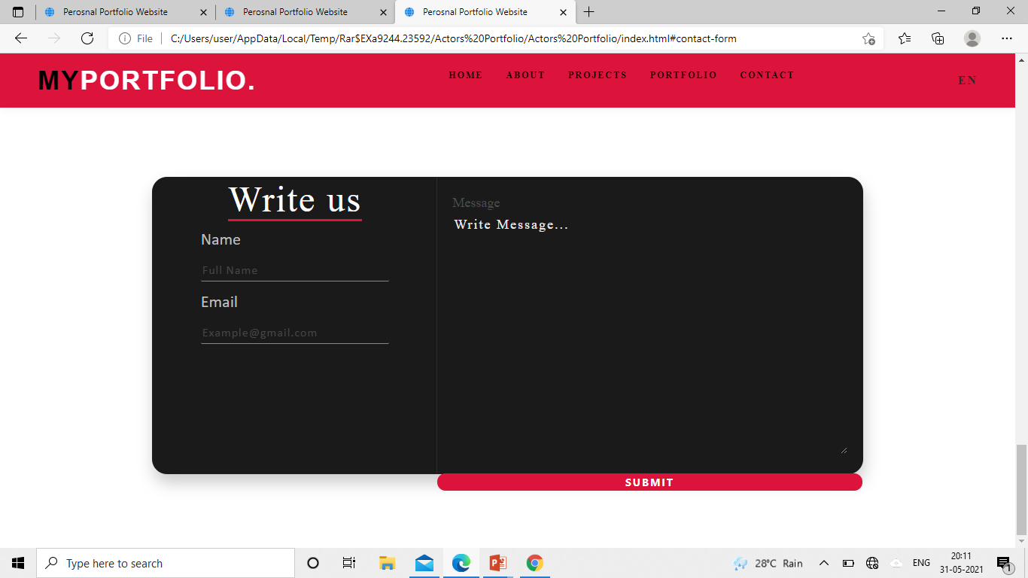
Contact details page:
Here in this page it contain contact details where the person have any ideas about new scripts and new films.we contact in this page or any queries also.

Slide 10
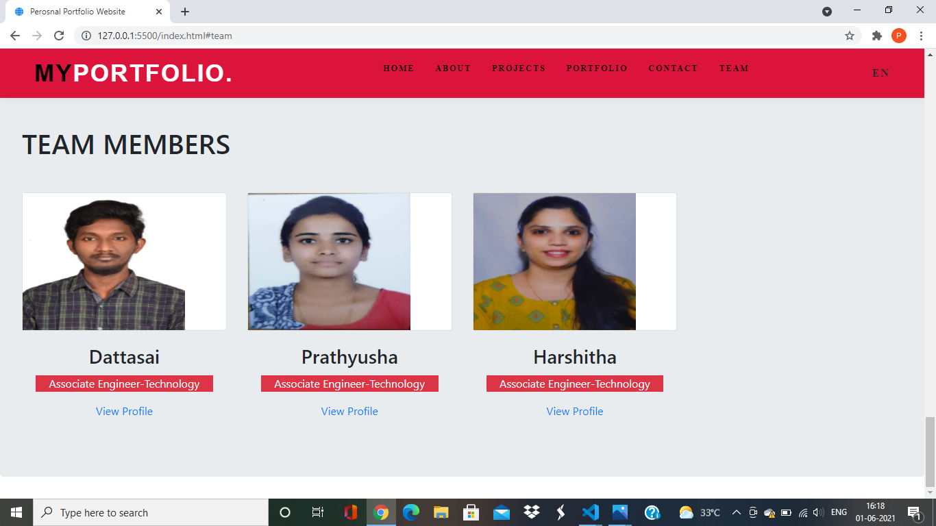
Team Members:

Slide 11


